Slide 1
an International CBSE Finger Print School
Coimbatore
SUBJECT NAME-ACCOUNTANCY
GRADE-XII
UNIT 1 – PROBLEM SOLVING-PARTNERSHIP BASIC CONCEPTS
TOPIC 1 – PROFIT AND LOSS APPROPRIATION

Slide 2
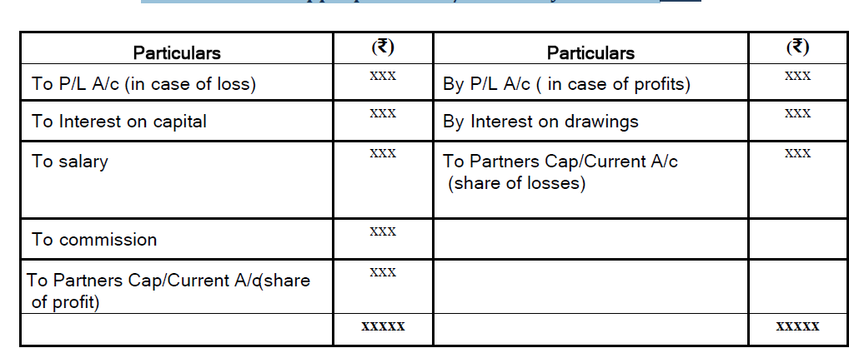
Profit and Loss Appropriation A/c for the year ended
.

Slide 3
Calculation of Interest on Drawings
When varying amounts are withdrawn at different intervals
Interest is calculated through Product method and given for 1 month
Total product X R/100 X 1/12
When fixed amount is withdrawn
a) At the beginning of each month
b) At the end of each month
c) During the month or mid of each month
a) Total drawings X R/100 X 6.5/12
b) Total drawings X R/100 X 5.5/12
c) Total drawings X R/100 X 6/12
When fixed amount is withdrawn
a) Total drawings X R/100 X 7.5/12

Slide 4
a) In the beginning of each quarter
b) In the end of each quarter
b) Total drawings X R/100 X 4.5/12
4
When fixed amount is withdrawn
a) In the beginning of each half year
b) In the end of each half year
a) Total drawings X R/100 X 9/12
b) Total drawings X R/100 X 3/12
.

Slide 5
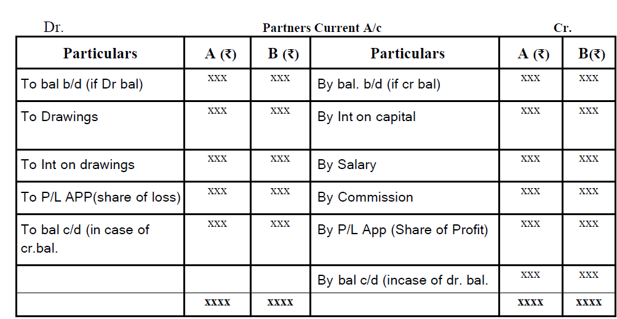
PARTNERS CAPITAL ACCOUNT

Slide 6
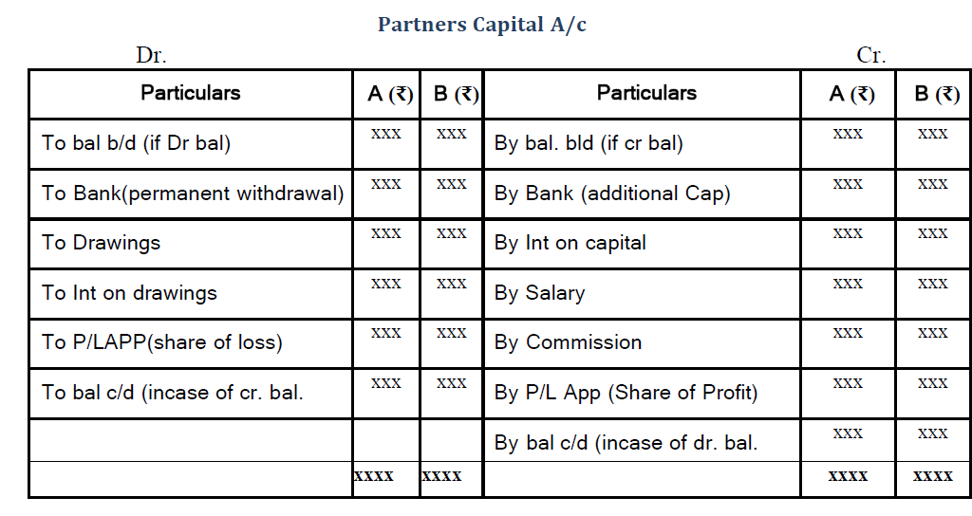

Slide 7
A, B and C are partners with fixed capitals of 1,00,000 , 200,000 and
3,00,000 respectively. Their partnership deed provides that :
(a) A is to be allowed a monthly salary of 600 and B is to be allowed a
monthly salary of 400.
(b) C will be allowed a commission of 5% of the net profit after
allowing salaries of A and B.
(c) Interest is to be allowed on capitals @ 6%.
(d) Interest will be charged on partners annual drawings at 4%.
(e) The annual drawings were :B 10,000 and C 15,000.
The net profit for the year ending 31st march, 2014 amounted to
1,72,000.
Prepare P&L Appropriation account.

Slide 12
https://web.stanford.edu/class/cs227/Lectures/lec14.pdf
http://aima.cs.berkeley.edu/newchap05.pdf
https://www.seas.upenn.edu/~cis391/Lectures/CSP.pdf
https://www.cs.ubc.ca/~poole/aibook/html/ArtInt_76.html
https://nptel.ac.in/courses/106/106/106106158/

